Slide 1

Cloud Development 1A
Theme 1: Module Outline + Introduction
CLDV6212
BCA1
Faculty of Science and Technology: School of Computer Science
Lecturer: Byron McCall
Email: bmcall@varsitycollege.co.za

Slide 2
Recap of Azure Event Hubs
Definition and Purpose:
Azure Event Hubs is a scalable data streaming platform and event ingestion service.
It can process millions of events per second, making it ideal for big data and real-time analytics solutions.
Architecture Overview:
Event Producers: Devices, applications, and services that send data to Event Hubs.
Event Hubs Namespace: A container for managing one or more Event Hubs.
Event Hub: A stream of events.
Partitions: Sub-divisions of an Event Hub to parallelize the processing.
Consumer Groups: Provide views of the event stream, allowing multiple applications to independently consume data.
Key Features:
High Throughput: Capable of handling large volumes of data with low latency.
Real-time Analytics: Supports real-time data processing with Azure Stream Analytics.
Scalability: Easily scales to handle more data by adding throughput units.
Integration: Integrates seamlessly with other Azure services like Azure Functions, Azure Stream Analytics, and Azure Data Lake.
Use Cases:
IoT Data Ingestion: Collecting data from IoT devices for real-time processing.
Application Logging: Aggregating logs from multiple applications for monitoring and analysis.
Live Dashboarding: Providing real-time updates on dashboards by ingesting and processing live data feeds.
Clickstream Analysis: Analysing user interactions on websites in real-time for personalized experiences.

Slide 3
Building Data Pipelines
Definition:
Data Pipeline: A series of processes that move data from a source to a destination, transforming and processing it along the way.
Components of a Data Pipeline:
Data Sources:
Definition: Origin of data.
Examples: IoT devices, web applications, mobile apps, backend services.
Ingestion Layer:
Definition: Mechanism to collect and transport data to the processing layer.
Tools: Azure Event Hubs, Azure IoT Hub.
Processing Layer:
Definition: Transforming, analysing, and enriching data.
Tools: Azure Stream Analytics, Azure Databricks, Azure Functions.
Storage Layer:
Definition: Saving processed data for further use.
Tools: Azure Blob Storage, Azure Data Lake Storage, Azure SQL Database.
Importance of Data Pipelines:
Scalability: Handle large volumes of data efficiently.
Real-time Processing: Enable immediate insights from streaming data.
Data Integration: Combine data from multiple sources for comprehensive analysis.
Automation: Reduce manual intervention, ensuring consistent and reliable data flow.

Slide 4
Data Producers and Event Hubs Integration
Definition:
Data Producers: Applications, services, or devices that generate data to be ingested by Azure Event Hubs.
Examples of Data Producers:
IoT Devices:
Sensors, smart devices, and other IoT hardware that collect data from the physical world.
Web Applications:
Websites and web services that generate event data such as user interactions, logs, and metrics.
Mobile Apps:
Mobile applications that produce data on user activity, location, and usage patterns.
Backend Services:
Server-side applications and microservices that emit logs, metrics, and other operational data.

Slide 5
Data Producers and Event Hubs Integration continued…
Integration Methods:
SDKs and APIs:
Azure provides SDKs for various programming languages (e.g., .NET, Java, Python) to easily integrate Event Hubs into applications.
Example Code Snippet (C#):
EventHubProducerClient producer = new EventHubProducerClient(connectionString, eventHubName);
using EventDataBatch eventBatch = await producer.CreateBatchAsync();
eventBatch.TryAdd(new EventData(Encoding.UTF8.GetBytes("Sample event data")));
await producer.SendAsync(eventBatch);
Azure IoT Hub:
A managed service that acts as a central message hub for bi-directional communication between IoT applications and devices.
IoT Hub can route device telemetry to Event Hubs for further processing.
Custom Connectors:
Developing custom solutions to connect various data sources to Event Hubs using REST APIs or other integration tools.

Slide 6
Ingesting Data from Multiple Sources
Step-by-Step Guide:
Identify Data Sources:
Determine the sources of data to be ingested (e.g., IoT devices, web apps, mobile apps, backend services).
Set Up Event Hubs:
Create and configure Event Hubs to receive data from each source.
Example: Create an Event Hub for IoT devices and another for web application logs.
Develop Data Producers:
Write code or use tools to send data to Event Hubs from each data source.
Example: Use Azure SDKs to develop applications that send data to Event Hubs.
Monitor Ingestion:
Use the Azure Portal to monitor the flow of data into Event Hubs.
Check metrics such as incoming messages, throughput, and errors.

Slide 7
Processing and Storing Ingested Data
Processing Options:
Real-time Processing:
Tool: Azure Stream Analytics
Function: Processes data in motion, providing real-time insights.
Example: Analysing sensor data from IoT devices to detect anomalies.
Batch Processing:
Tool: Azure Data Factory
Function: Orchestrates and automates data movement and transformation at scale.
Example: Aggregating daily logs from a web application for end-of-day analysis.
Storage Solutions:
Azure Blob Storage:
Purpose: Scalable object storage for unstructured data.
Use Case: Storing large volumes of raw event data.
Azure Data Lake Storage:
Purpose: Designed for big data analytics, supports hierarchical file systems.
Use Case: Storing processed and unprocessed big data for analytics.
Azure SQL Database:
Purpose: Relational database service for structured data.
Use Case: Storing processed data that needs to be queried using SQL.

Slide 8
Practical Exercise: Building a Data Pipeline with Azure Event Hubs
Steps:
Create an Azure Event Hub:
Go to the Azure Portal.
Create a new Event Hubs Namespace.
Within the namespace, create an Event Hub named DemoEventHub.
Set Up Data Producers:
IoT Device Simulation:
Use a C# console application to simulate IoT devices sending data to DemoEventHub.
Monitor Event Hub:
In the Azure Portal, navigate to your Event Hub.
Check the metrics to ensure messages are being received.

Slide 9
Continued
using System;
using System.Text;
using System.Threading.Tasks;
using Azure.Messaging.EventHubs;
using Azure.Messaging.EventHubs.Producer;
class Program
{
private const string connectionString = "your_connection_string";
private const string eventHubName = "DemoEventHub";
static async Task Main(string[] args)
{
await SendMessagesToEventHub(5);
}
private static async Task SendMessagesToEventHub(int numMessages)
{
await using (var producerClient = new EventHubProducerClient(connectionString, eventHubName))
{
using EventDataBatch eventBatch = await producerClient.CreateBatchAsync();
for (int i = 0; i < numMessages; i++)
{
eventBatch.TryAdd(new EventData(Encoding.UTF8.GetBytes($"Message {i}")));
}
await producerClient.SendAsync(eventBatch);
Console.WriteLine($"{numMessages} messages sent.");
}
}
}

Slide 10
Real-World Use Cases of Azure Event Hubs
1. Internet of Things (IoT):
Scenario: Ingesting data from thousands of IoT sensors in a smart city.
Details: Sensors collect data on traffic, weather, air quality, and energy consumption. Azure Event Hubs ingests this data, which is then processed in real-time to optimize city operations and improve residents' quality of life.
2. Financial Services:
Scenario: Real-time fraud detection in financial transactions.
Details: Financial institutions use Azure Event Hubs to ingest transaction data in real-time. Stream Analytics processes this data to identify patterns indicative of fraudulent activity, enabling immediate action to prevent fraud.
3. E-commerce:
Scenario: Real-time personalization and recommendation engine.
Details: E-commerce platforms collect user behavior data, such as clicks and purchases, through Azure Event Hubs. This data is analyzed in real-time to provide personalized product recommendations, enhancing user experience and increasing sales.
5. Gaming:
Scenario: Real-time analytics for multiplayer gaming experiences.
Details: Game developers use Azure Event Hubs to collect real-time data on player actions, game states, and interactions. This data is analyzed to improve game mechanics, balance, and provide dynamic, real-time updates to players.

Slide 11
ICE2 Understand the concept of data ingestion with Azure Event Hubs through a simulated environment.
Activity Outline:
Introduction (10 minutes):
Briefly review what Azure Event Hubs is and how it works.
Explain the purpose of the activity: simulating data ingestion and processing.
Activity Instructions (5 minutes):
You will use a provided simulation script to emulate data ingestion and processing as if using Azure Event Hubs.
Simulation Setup (15 minutes):
Provide Students with a Simulation Script:
Script Overview: A C# console application that simulates data ingestion and processing.
Script Content: Includes a mock implementation of sending data to an Event Hub and processing it.
Hands-On Simulation (25 minutes):
Students Execute the Simulation Script:
Run the provided C# console application on their machines.
Observe the simulated data ingestion and processing.
Discussion and Wrap-Up (5 minutes):
Discuss: Key takeaways from the simulation.
Questions: Address any questions about the simulated data pipeline and how it relates to real-world Azure Event Hubs usage.

Slide 12
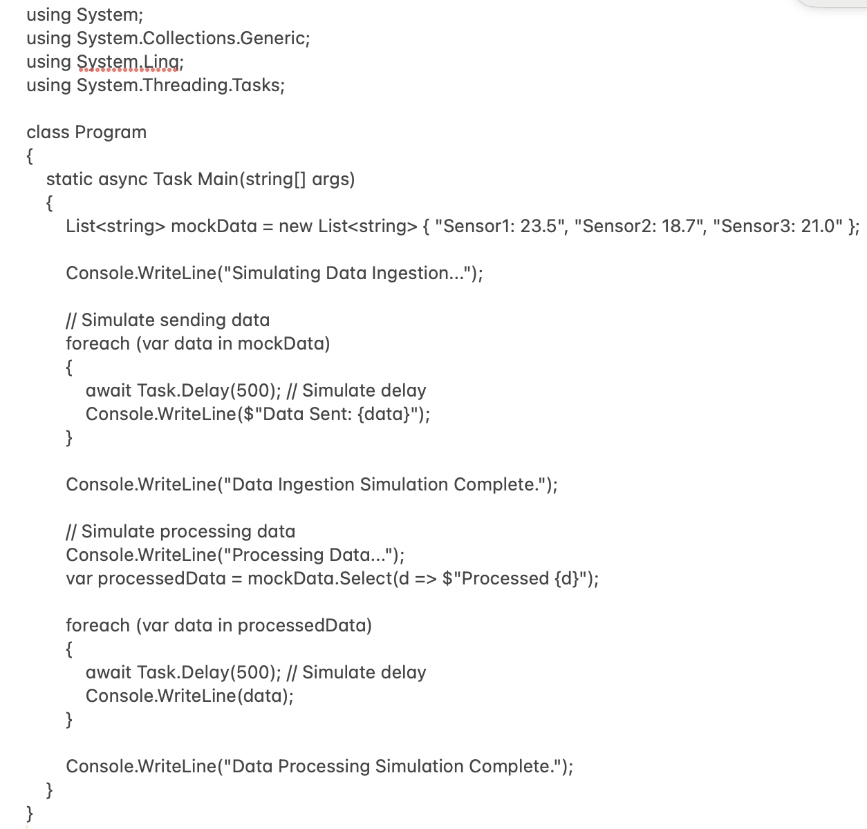
ICE2

